Slide 1
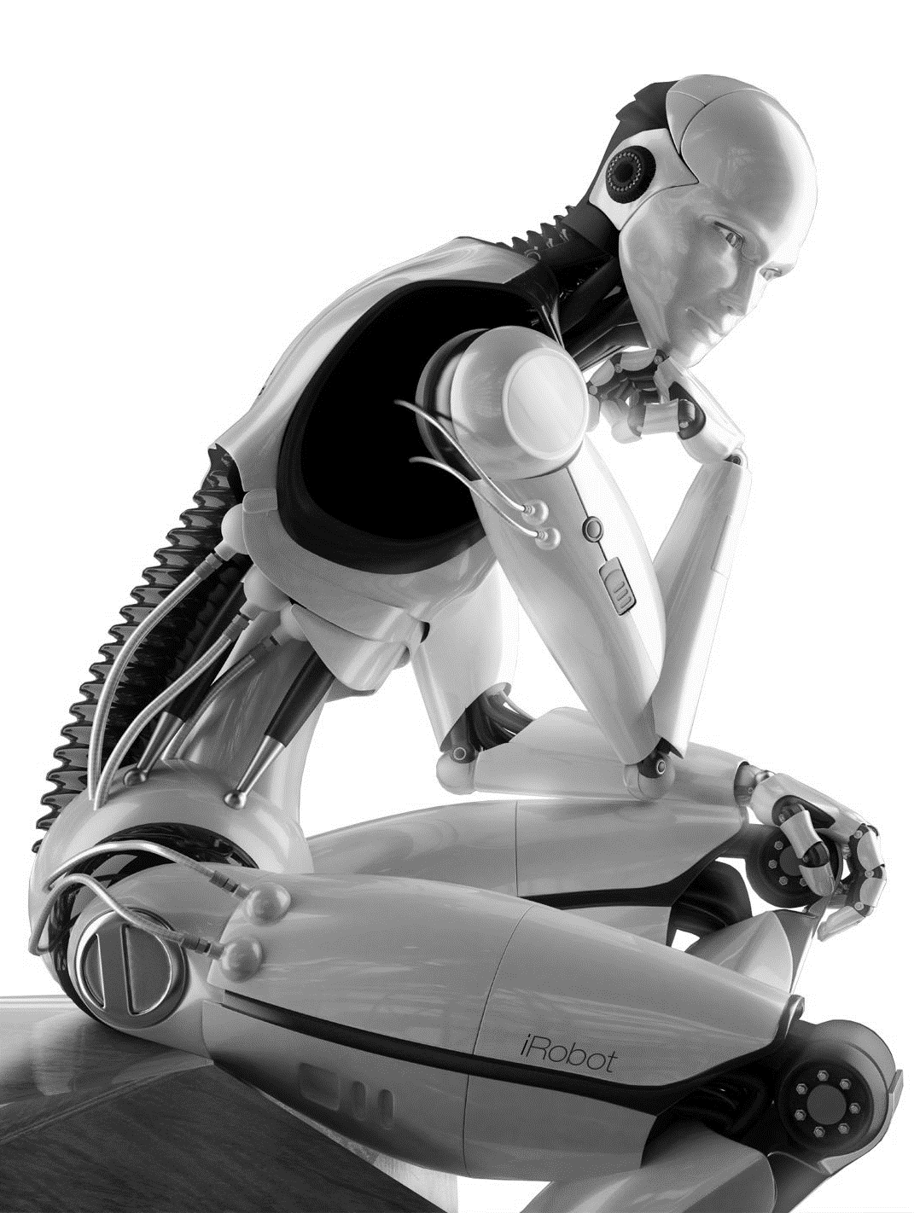


Guillaume MALOD Valery FARCY Karim HEDEOUD-PERROT
BIG DATA & DATASCIENCE
FOR BUSINESS SOLUTIONS
DATASCIENCE GUIDING PRINCIPLES
MODULE 1 LECTURE 3

Slide 2
M
1
Management de solutions métiers en Datascience & Big data
INTRODUCTION
DATA, technologies
& digitalisation
DataScience
Guiding Principles
DATA ANALYSIS
Process & mETHODS
ModEliNG
& algorithms
DataScience
EcosystEMS & TOOLS
DataScience
Project Management
CONCLUSION
M
M
M
M
2
3
3
3
4
4
4
4
5
5

Slide 3
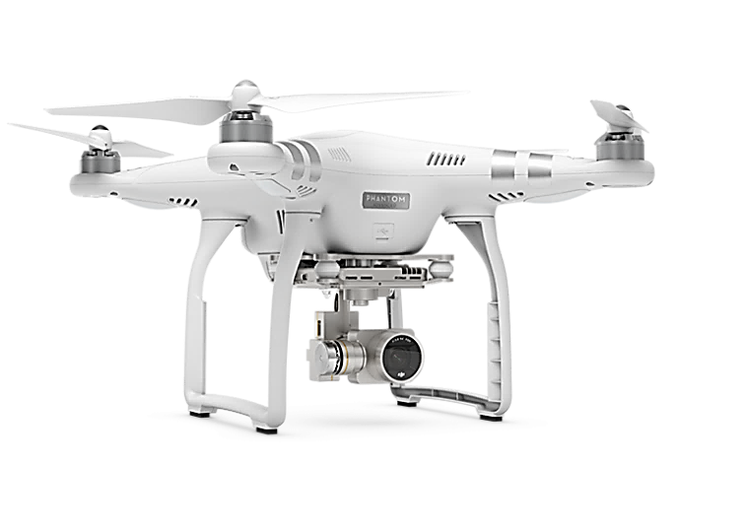
WHAT IS DATASCIENCE?
Data Science is the art of turning data into actionable information.
Business Data Science is the art of turning data trough actionable information into valuables actions.

Slide 4
WHAT IS DATASCIENCE?
BUSINESS
&
DOMAIN KNOWLEDGE
DATASCIENCE
COMPUTER
SCIENCE
MATHEMATICS
Deductive reasoning
(hypothesis-based)
TREND
Inductive reasoning
(pattern-based)

Slide 5




To
Up
You!
To Do:
- Give examples in the datascience range
Teamwork restitution (UK).
5
mn

Slide 6
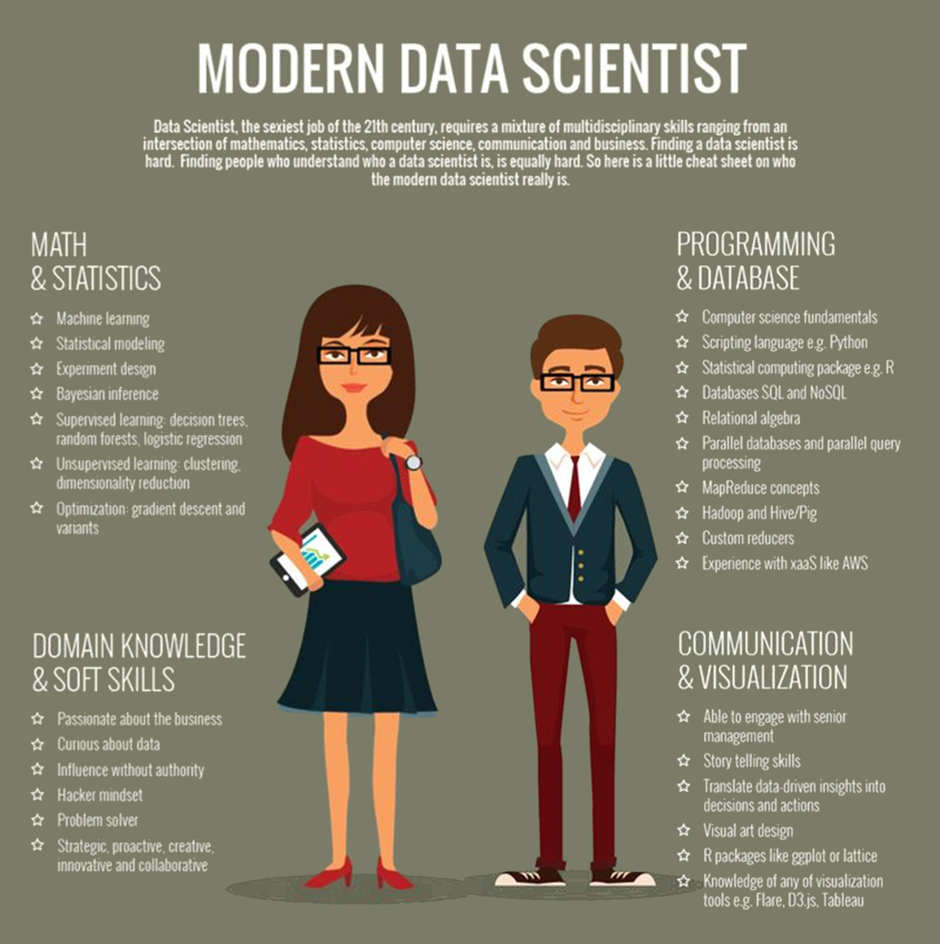

Slide 7
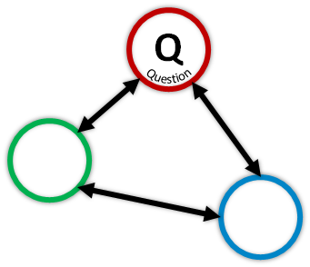
To
Up
You!
To Do:
- Starting with a Business Question, design a 3 step process to answer it from a DataScientist point of view.
- What are the goal step, how do you trigger the gate?
Teamwork restitution (UK).
10
mn

Slide 8

WHAT IS DATASCIENCE?
Q
Question
V
Validate
M
Modelize

Slide 9
DATASCIENCE & COMPUTER SCIENCE
COMPUTER SCIENCE: The study of automating algorithmic processes that scale.
COMPUTER SCIENCE
ARTIFICIAL INTELLLIGENCE: An ideal "intelligent" machine is a flexible rational agent that perceives its environment and takes actions that maximize its chance of success at an arbitrary goal.
ARTIFICIAL
INTELLLIGENCE
MACHINE
LEARNING
MACHINE LEARNING :The study and construction of algorithms that can learn from and make predictions on data.
DEEP
LEARNING
DEEP LEARNING: is a branch of machine learning based on a set of algorithms that attempt to model high-level abstractions

Slide 10
To
Up
You!
To Do:
- Give a field definition of Learning.
Teamwork restitution (UK).
5
mn

Slide 11
WHAT IS LEARNING?
“Learning is the acquisition of knowledge or skills through experience, study, or by being taught.”
"Learning is any process by which a system improves performance from experience."
Herbert A. Simon

Slide 12



WHAT IS LEARNING?
{ EXAMPLE, ANSWER }
FEATURE EXTRACTION
PATTERN LEARNING
CLASSIFICATION
== GOOD
== BAD
GOOD
BAD
== GOOD
Feature
selection
{ color, shape, …, texture }
Apply some form of infered rules to new example to predict answer.
{ $x_{1}$, $x_{2}$, $x_{i}$, …..…….…, $x_{d}$ }
LABEL ?
?
SUPERVISED LEARNING
generalizing from examples + correct answers
GOOD
==
x
BAD

Slide 13
WHAT IS LEARNING?
{ EXAMPLE }, no answer
FEATURE EXTRACTION
PATTERN LEARNING
CLASSIFICATION
Feature
selection
{ color, shape, …, texture }
Apply some form of similarity to new example to predict answer.
{ $x_{1}$, $x_{2}$, $x_{i}$, …..…….…, $x_{d}$ }
UNSUPERVISED LEARNING
Similarity insight from examples
Which cluster?

Slide 14

WHAT IS LEARNING?
{ EXAMPLE }, no answer
FEATURE EXTRACTION
PATTERN LEARNING
CLASSIFICATION
1
2
3
4
6
5
7
8
REINFORCEMENT LEARNING
Rewards / Penalties Learning
9

Slide 15
To
Up
You!
To Do:
- Give a field definition of Machine Learning,
Teamwork restitution (UK).
15
mn

Slide 16
WHAT IS MACHINE LEARNING?
“The study that gives computers the ability to learn without being explicitly programmed."
Arthur Samuel (1959)
“Machine Learning is the science of getting computers to act without being explicitly programmed.”
Andrew Ng (2009)
Machine learning refers to an area of computer science in which patterns are derived (“learned”) from data with the goal to make sense of previously unknown inputs.
Maria Schulda (2014)
Notes:
For example, assume that you have a collection of pictures.
Each picture depicts either a dog or cat. A task could be sorting the pictures
into separate collections of dog and cat photos. A program could learn to perform
this task by observing pictures that have already been sorted, and it could evaluate its performance by calculating the percentage of correctly classified pictures.

Slide 17















WHAT IS MACHINE LEARNING?
"A program can be said to learn from experience E with respect to some class of tasks T and performance measure P, if its performance at tasks in T, as measured by P, improves with experience E."
Tom Mitchell (1977)
Input ($X_{i}$) = Images features
Training experience (E): represented by a set of handwritten numbers with given classifications
Task (T): recognizing & classifying handwritten numbers within images
Performance measure (P): percent of numbers correctly classified
0
1
2
3
4
5
6
7
8
9
Output (Y)= Class labels { $y^{0},$ $y^{1},$ $y^{2}…y^{9} \}$
Notes:
more formally

Slide 18
WHAT IS MACHINE LEARNING?
Machine Learning Systems:
- improve their Performance
- at some Task
- with Experience
MACHINE LEARNING SYSTEM
Data
Input
Output
Understanding
Experience
Task
Performance

Slide 19

WHAT IS MACHINE LEARNING?
Data
Computer
Output
Program
Observable
phenomena
Classic Programming
Data
Data
Computer
Computer
Output
Program
Output
Machine Learning

Slide 20
WHAT IS MACHINE LEARNING?
Feature selection is also called variable selection or attribute selection.
The goal is to select (automaticaly or handcraft) attributes in the dataset that are most relevant to the predictive modeling problem.
Data
Observable
phenomena
Data
Computer
Computer
Output
Program
Output
Machine Learning

Slide 21
To
Up
You!
To Do:
- Given some examples of features?
- What can be the main problems with feature extractions?
Teamwork restitution (UK).
15
mn

Slide 22
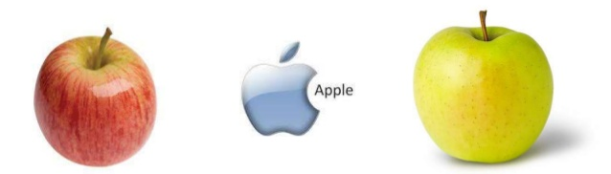
WHAT IS MACHINE LEARNING?
Good features are informative, independent, and simple

Slide 23
WHAT IS MACHINE LEARNING?
Machine Learning uses computers to perform predictive models that learn from existing data to predict trends, performance and future behaviors without being explicitly programmed.
Training information
Output Labels
Rewards / Penalties
MACHINE LEARNING SYSTEM
Data
Informations
Patterns, Hidden Structures
Relationships, Dependencies
Model
Optimum
Algorithms + Techniques
Notes:
L’apprentissage automatique utilise des ordinateurs pour exécuter des modèles prédictifs qui apprennent à partir de données existantes afin de prévoir les tendances, résultats et comportements futurs.

Slide 24
WHAT IS MACHINE LEARNING?
Existing datasets from an observable phenomena with digital representations.
The training datasets on which the predictive function is learned are representative of the general problem to solve.
Training information
Output Labels
Rewards / Penalties
MACHINE LEARNING SYSTEM
Observable phenomena
with
digital representations
Data
Informations
Patterns, Hidden Structures
Relationships, Dependencies
Model
Optimum
Algorithms + Techniques
Notes:
L’apprentissage automatique utilise des ordinateurs pour exécuter des modèles prédictifs qui apprennent à partir de données existantes afin de prévoir les tendances, résultats et comportements futurs.

Slide 25

WHAT IS MACHINE LEARNING?
Machine Learning is about approximation. The target function is unknow and will remain unknown
Keep in mind that the approximitted functions are probability distribution.
Unsupervised Learning: p(x,y)
MACHINE LEARNING SYSTEM
Observable phenomena
with
digital representations
Classification: p(x|y)
Prediction: p(y|x)

Slide 26

WHAT IS MACHINE LEARNING?
The goal is to predict the responses for further observations with the lowest average possible prediction error.
The aim is to generalize as possible from a finite set of observations.
Training information
Output Labels
Rewards / Penalties
MACHINE LEARNING SYSTEM
PRODUCTION PLATFORM
Observable phenomena
with
digital representations
Data
Informations
Patterns, Hidden Structures
Relationships, Dependencies
Model
Optimum
Deployed
Model
New
Data
Algorithms + Techniques
Predicted
Outputs
$ε_{min}$= f(Further observation outputs - Predicted outputs)
Notes:
L’apprentissage automatique utilise des ordinateurs pour exécuter des modèles prédictifs qui apprennent à partir de données existantes afin de prévoir les tendances, résultats et comportements futurs.

Slide 27
WHAT IS MACHINE LEARNING?
The goal is to predict the responses for further observations with the lowest average possible prediction error.
The aim is to generalize as possible from a finite set of observations.
Training information
Output Labels
Rewards / Penalties
MACHINE LEARNING SYSTEM
PRODUCTION PLATFORM
Observable phenomena
with
digital representations
Data
Informations
Patterns, Hidden Structures
Relationships, Dependencies
Model
Optimum
Deployed
Model
New
Data
Algorithms + Techniques
Predicted
Outputs
$ε_{min}$= L(Further observation outputs - Predicted outputs)
Notes:
L’apprentissage automatique utilise des ordinateurs pour exécuter des modèles prédictifs qui apprennent à partir de données existantes afin de prévoir les tendances, résultats et comportements futurs.

Slide 28
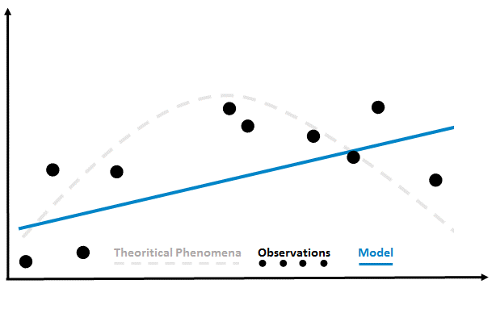
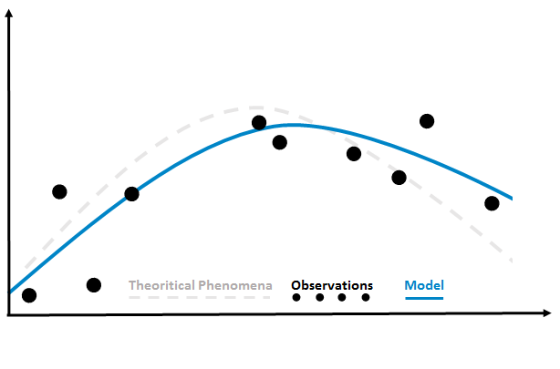
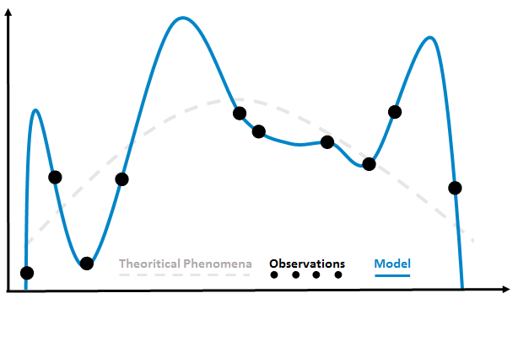



WHAT IS MACHINE LEARNING?
The goal is not to induce a function exactly giving the desired training set observations outputs, but to find the function that will be good generalization performance.
Poor generalization
under-fitting
Good generalization
right-fitting
Poor generalization
over-fitting
${y=θ}_{0}$+$θ_{1}x^{1}$
${y=θ}_{0}$+$θ_{1}x^{1}$+$θ_{2}x^{2}$
${y=θ}_{0}$+$θ_{1}x^{1}$+$θ_{2}x^{2}\text{+}θ_{3}x^{3}$+$θ_{4}x^{4}$
-
+
Model complexity
Notes:
L’apprentissage automatique utilise des ordinateurs pour exécuter des modèles prédictifs qui apprennent à partir de données existantes afin de prévoir les tendances, résultats et comportements futurs.

Slide 29
WHAT IS MACHINE LEARNING?
rigth
fitting
under-fitting
over-fitting
Error for unseen data
Variance
High Biais,
High Variance
Low Biais,
Low Variance
Prediction Error
High Biais,
Low Variance
Low Biais,
High Variance
Optimum
Biais
-
Model complexity
+
Biais: is the loss incurred by the main prediction relative to the optimal prediction.
Variance: is the average loss incurred by predictions relative to the main prediction.

Slide 30
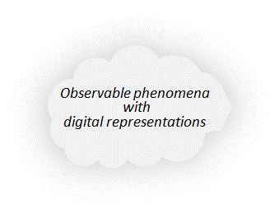

WHAT IS MACHINE LEARNING?
The process of finding a general rule from a finite set of observations is called induction.
FURTHER OUTPUT
$$ε_{min}$$
PREDICTED OUTPUT
GENERALIZATION PERFORMANCE
NEW DATA
Notes:
L’apprentissage automatique utilise des ordinateurs pour exécuter des modèles prédictifs qui apprennent à partir de données existantes afin de prévoir les tendances, résultats et comportements futurs.

Slide 31
To
Up
You!
To Do:
- Given the generalization paradigm, the biais & variance, how can the experience dataset be organized to test & validate the model?
Teamwork restitution (UK).
15
mn

Slide 32
WHAT IS MACHINE LEARNING?
TRAINING STAGE
TEST STAGE
Training Dataset
Validation Dataset
2O%
Testing Dataset
2O%
6O%
10O% dataset
Goal: model learning & definition
Goal: Model hyperparameter testing
Goal: Generalization testing for selected model.
best model selection iterations
model testing on unseen data
Model cross validation
we don’t have access to the function we want to optimize! We have to use training error as a sur-rogate for test error.

Slide 33
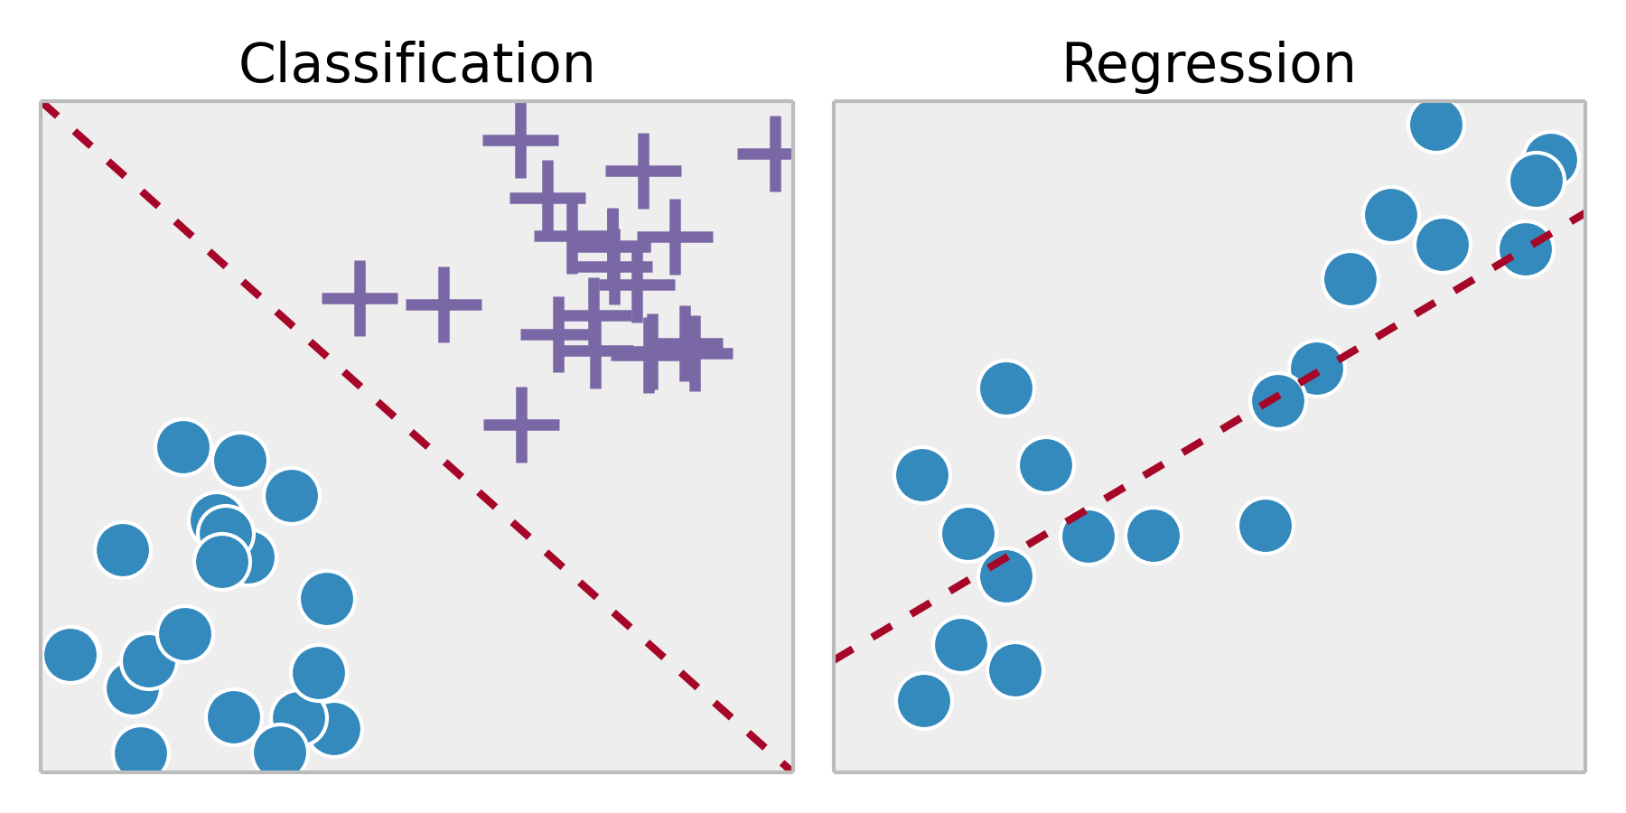
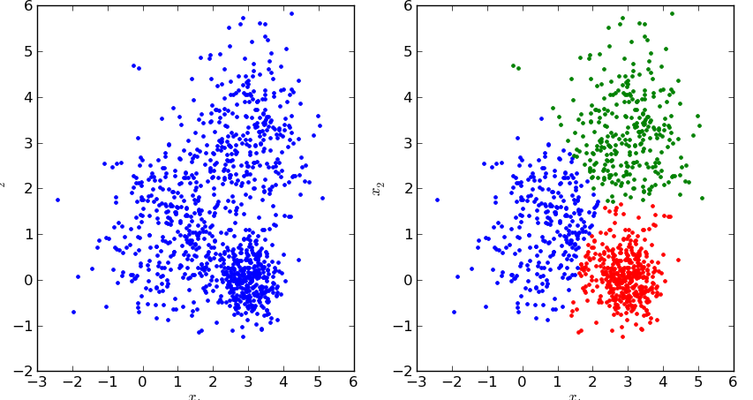
WHAT IS MACHINE LEARNING?
LEARNING TYPE
SUPERVISED LEARNING
Labeled training data
REINFORCEMENT LEARNING
Reward-based training
UNSUPERVISED LEARNING
Unlabeled training data
Classification task
Clustering task
Regression task
Dimension reduction task
Training information
Output Labels
Training information
Rewards / Penalties
MACHINE LEARNING SYSTEM
MACHINE LEARNING SYSTEM
MACHINE LEARNING SYSTEM
Data
Output
Data
Output
Data
Output
Algorithms + Techniques
Algorithms + Techniques
Algorithms + Techniques
Machine predicts an output for an input by learning from pairs of labeled inputs & outputs.
It learns from examples of the right answers.
Machine receives feedback for its decisions.
Reward reinforces the current strategy, while punishment leads to an adaptation.
Machine does not learn from labeled data.
It attempts to discover clusters to summarize amounts of information by few stereotypes.
Classification
Regression
Machine learning to play PacMan
original data
clustered data

Slide 34
To
Up
You!
To Do:
- Give a field definition of an Algorithm,
Teamwork restitution (UK).
10
mn

Slide 35


WHAT IS MACHINE LEARNING?
Aditional Training information
None, Output Labels Y, Rewards/Penalities
3 components of learning algorithms
Representation | Evaluation | Optimization
Choosing a representation for a machine learning system == Choosing the set of classifiers (hypothesis space) that it can possibly learn. If a classifier is not in the hypothesis space, it cannot be learned. | Evaluation function (objective function or scoring function) distinguishes good classifiers from bad ones. | A method to search among the classifiers for the highest-scoring one. The choice of optimization technique is key to the efficiency of the machine learning system.
Evaluation
Data
Informations
Model
Optimum
Representation
Optimization
Source: adapted from Pedros Domingos

Slide 36
WHAT IS MACHINE LEARNING?
Aditional Training information
None, Output Labels Y, Rewards/Penalities
3 components of learning algorithms
Representation | Evaluation | Optimization
Instances - K-nearest neighbor - Support vector machines Hyperplanes - Naive Bayes - Logistic regression Decision trees Sets of rules - Propositional rules - Logic programs Neural networks Graphical models - Bayesian networks - Conditional random fields | Accuracy/Error rate Precision and recall Squared error Likelihood Posterior probability Information gain K-L divergence Cost/Utility Margin | Combinatorial optimization - Greedy search - Beam search - Branch-and-bound Continuous optimization Unconstrained - Gradient descent - Conjugate gradient - Quasi-Newton methods Constrained - Linear programming - Quadratic programming
Evaluation
Data
Informations
Model
Optimum
Representation
Optimization
Source: adapted from Pedros Domingos

Slide 37
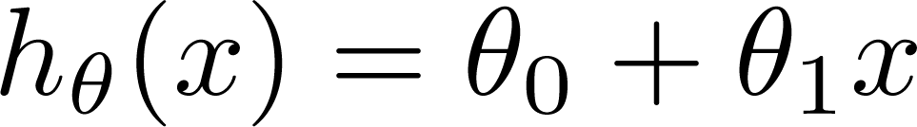
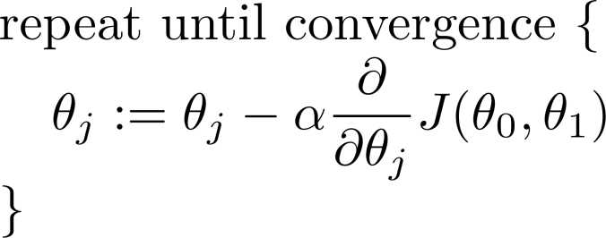
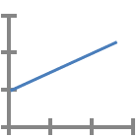
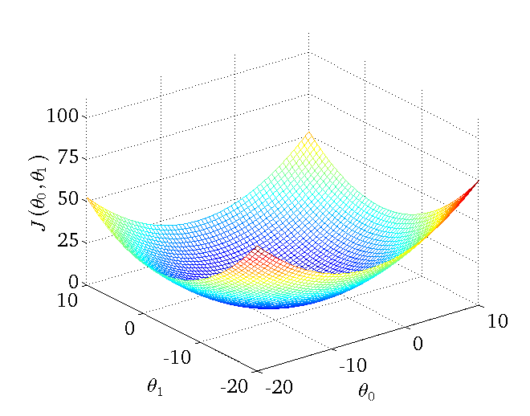
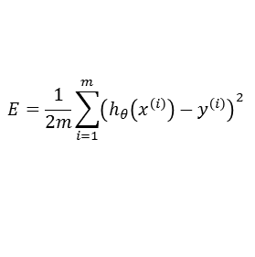
WHAT IS MACHINE LEARNING?
Aditional Training information
None, Output Labels Y, Rewards/Penalities
3 components of learning algorithms
Representation | Evaluation | Optimization
Evaluation
Data
Informations
Model
Optimum
Representation
Linear Regression
Squared error
Gradient descent
$$E=\frac{1}{2m}\sum_{i=1}^{m}{{\left(h_{θ}\left(x^{\left(i\right)}\right)−y^{\left(i\right)}\right)}^{2}}$$
Optimization

Slide 38
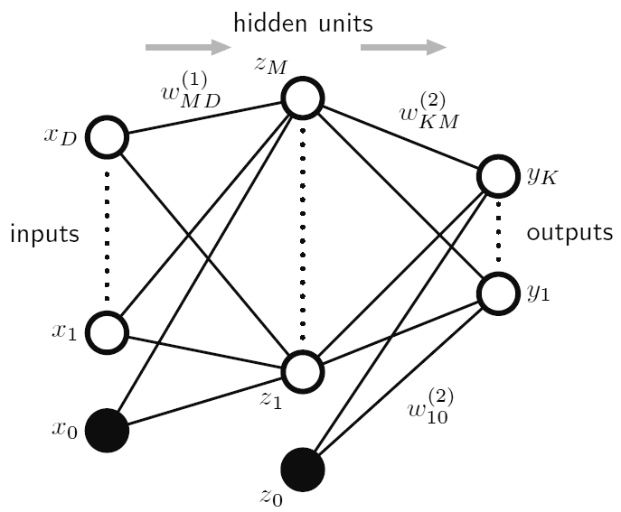
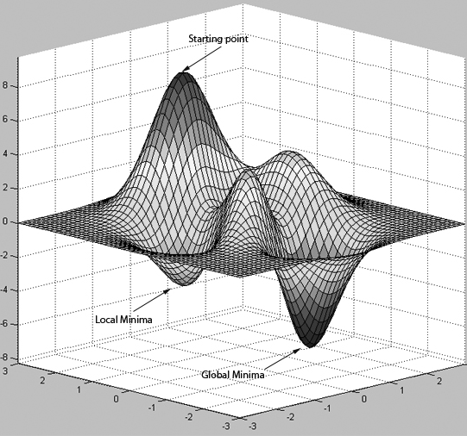

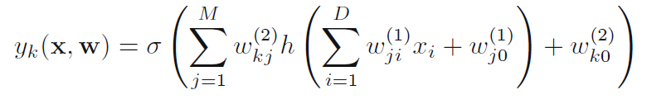
WHAT IS MACHINE LEARNING?
Aditional Training information
None, Output Labels Y, Rewards/Penalities
3 components of learning algorithms
Representation | Evaluation | Optimization
Evaluation
Data
Informations
Model
Optimum
Representation
Neural network
Squared error
Gradient descent
Optimization

Slide 39
WHAT IS MACHINE LEARNING?
Aditional Training information
None, Output Labels Y, Rewards/Penalities
Data is not enough
Every learner must embody some knowledge or assumptions beyond the data it’s given in order to generalize beyond it.
One of the key criteria for choosing a representation is which kinds of knowledge are easily expressed in it
Evaluation
Data
Informations
Model
Optimum
Representation
Optimization

Slide 40
WHAT IS MACHINE LEARNING?
Aditional Training information
None, Output Labels Y, Rewards/Penalities
not only one model
The fundamental goal of machine learning is to generalize beyond the examples in the training set.
Evaluation
Data
Informations
Model
Optimum
Representation
Optimization
Source: adapted from Pedros Domingos

Slide 41

WHAT IS MACHINE LEARNING?

Slide 42
Chabane HIMMI Gabriel ROUSSEAU Armel FOTSHE Guillaume MALOD Valery FARCY Karim HEDEOUD-PERROT
BIG DATA & DATASCIENCE
FOR BUSINESS SOLUTIONS
DATASCIENCE GUIDING PRINCIPLES
MODULE 1 LECTURE 3

